Slide 1
POLYLOOPER
Advanced Coding Tools and Methodologies Project
A.A. 2021 2022
TOMMASO GAMBINI –10796569
SIMONE SECHI – 10806125
MARCO VIVIANI – 10528650
GIOVANNI ZANOCCO - 10619659

Slide 2
What is Polylooper?
Polylooper is a web app that assists the user in creating polyrhythms. The user will play live different tracks associated to different metronomes in order to create a musical piece with different rhythms. In addition, every track is looped in order to simulate the effect of a loop pedal
The Goal: help the user, musician or not, in the creation of polyrhythms and in the management of different periodicities
Project associated with the course of Computer Music: Rapresentations and Models. In fact, another objective is to give a graphic representation of these polyrhythms

Slide 3
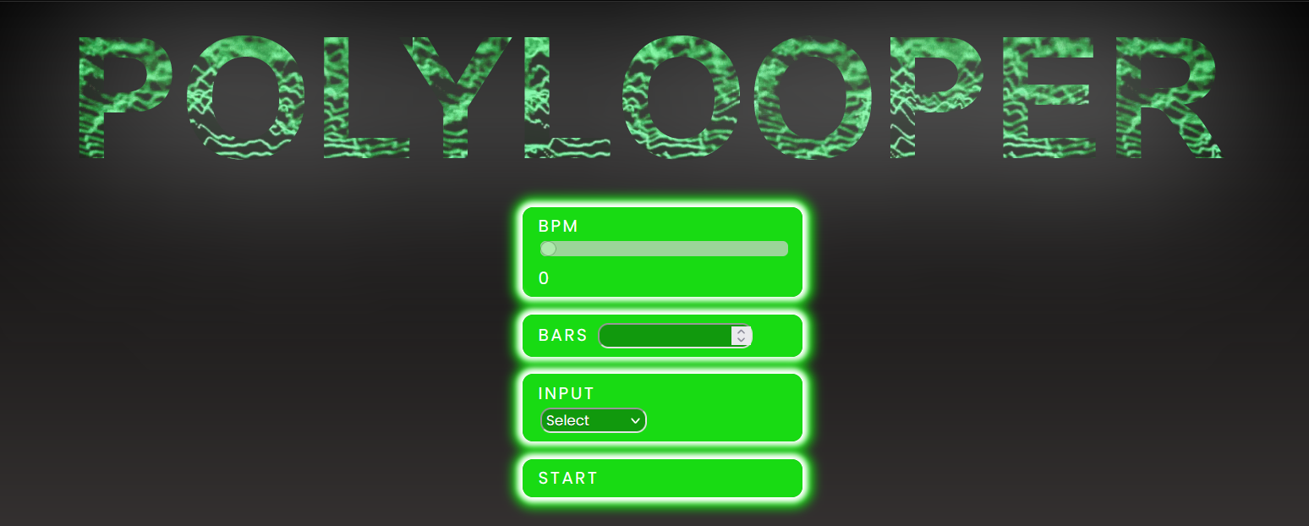
HOME MENU

Slide 4
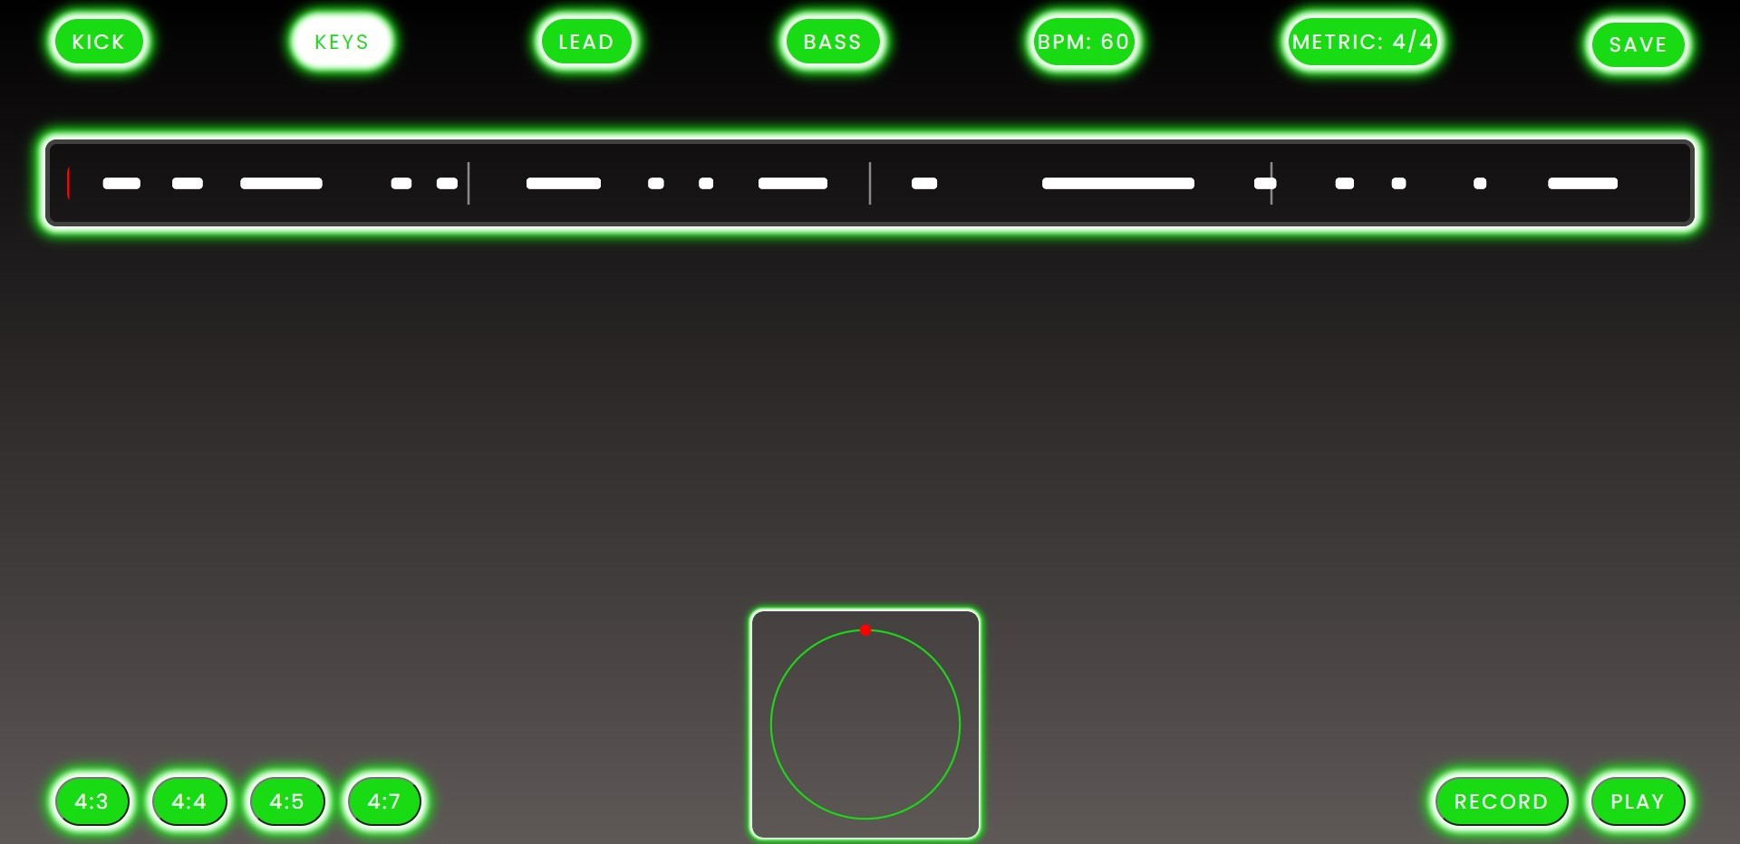
MANAGE THE TRACKS and PERIODICITIES
(second screen)

Slide 5
PROGRAMMING LANGUAGES, LIBRARIES and FRAMEWORKS
React
HTML5
JavaScript
Tone.js
WebMIDI.js

Slide 6

REACT
React is a JavaScript framework that creates user interfaces (UIs) in a predictable and efficient way using declarative code. You can use it to help build single page applications and mobile apps, or to build complex apps if you utilise it with other libraries.

Slide 7
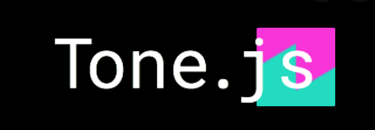
Tone.js
Tone.js is a Web Audio framework aimed to create interactive music and play it in a web browser. On the high level, Tone offers common DAW (digital audio workstation) features and prebuilt synths and effects. Additionally, Tone provides high performance building blocks to create your own synthesizers, effects and complex control signals.

Slide 8

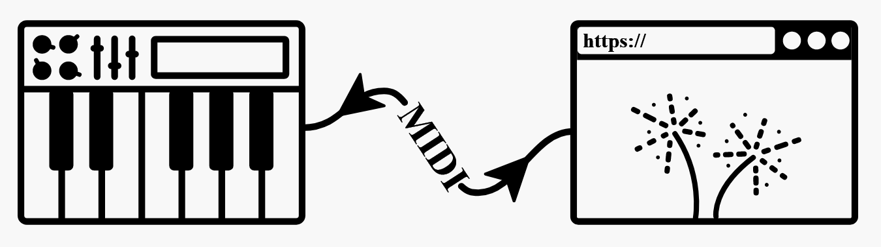
WEBMIDI.JS
The Web MIDI API is a addition to the web platform allowing a web page to interact with MIDI musical instruments.
The interfaces deal with the practical aspects of sending and receiving MIDI messages.
Therefore, the API can be used for musical and non-musical uses, with any MIDI device connected to your computer.

Slide 9
CHALLENGES AND FURTHER DEVELOPMENTS
Audio input from microphones in order to help musicians to record a great variety of instruments (useful for percussions)
More polyrhythms directly chosen by the user, not a priori
MIDI visualization as the note changes
Greater variety of MIDI instruments
Polimeters
Trascribe the MIDI file and save it
Choose the global time signature, now setted at 4/4: the display of polyrhythms varies depending on the metric
Polyrhythms that will depend on the chosen time signature

Slide 10
GITHUB
https://github.com/giozano/poliloop

